Slide 1


HI6040 (Artificial Intelligence and Machine Learning)
Dr. Farshid Keivanian

Slide 2
Welcome
Dear Students,
Welcome again to Week 2 of HI6040 – Artificial Intelligence and Machine Learning.
I hope you are beginning to settle into the trimester. This week, we take our first major step into practical applications of AI/ML using industry-standard tools such as Microsoft Azure ML Studio, Google Colab, and Anaconda-JupyterLab.
You’ll gain hands-on experience in setting up your machine learning development environments—both locally (on your device) and on the cloud—which is essential for completing your assessments and future professional tasks.
Please read the instructions below carefully and complete the steps during the tutorial or as directed by your tutor. This will help you stay on track and confidently build toward your upcoming tests and assignment.
Warm regards, Dr. Farshid Keivanian
Your Password to connect WiFi is your Holmes webmail password, or HiDD/MM/YYYY

Slide 3
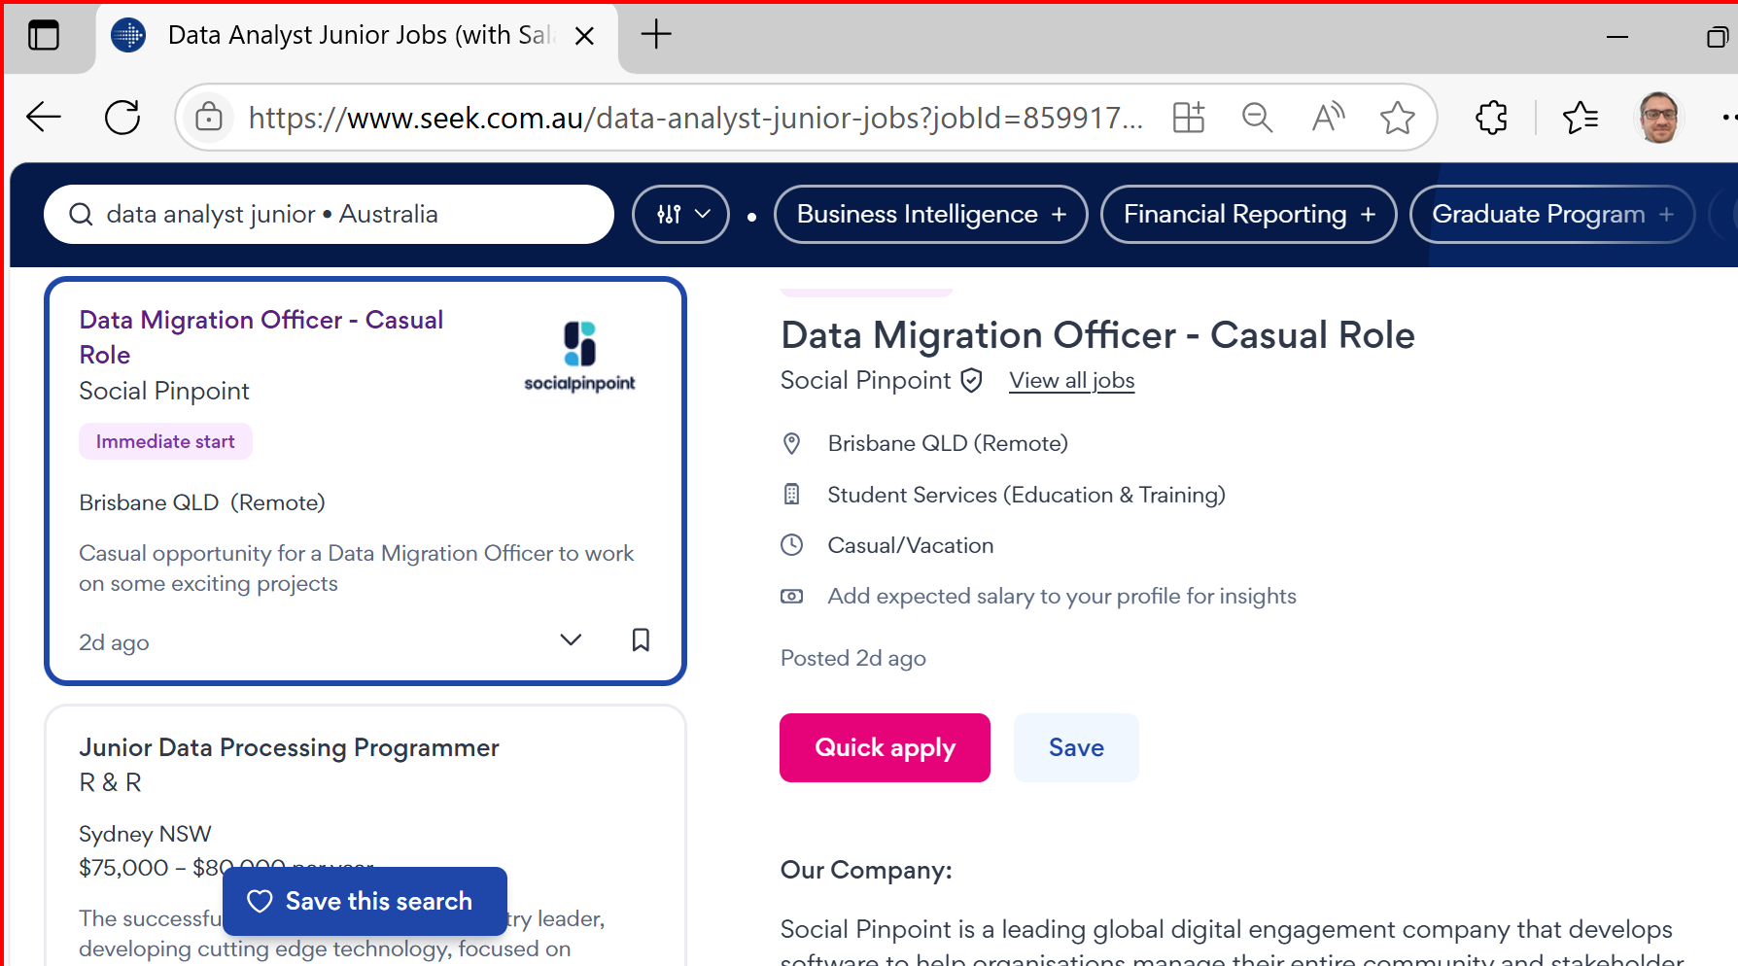
Career Opportunities & Certifications for ICT624 Graduates
Job Roles in Australia
Graduates of ICT624 – Advanced Data Analytics are well-positioned for roles such as:
Data Analyst: Interpret complex datasets to inform business decisions.

Slide 4
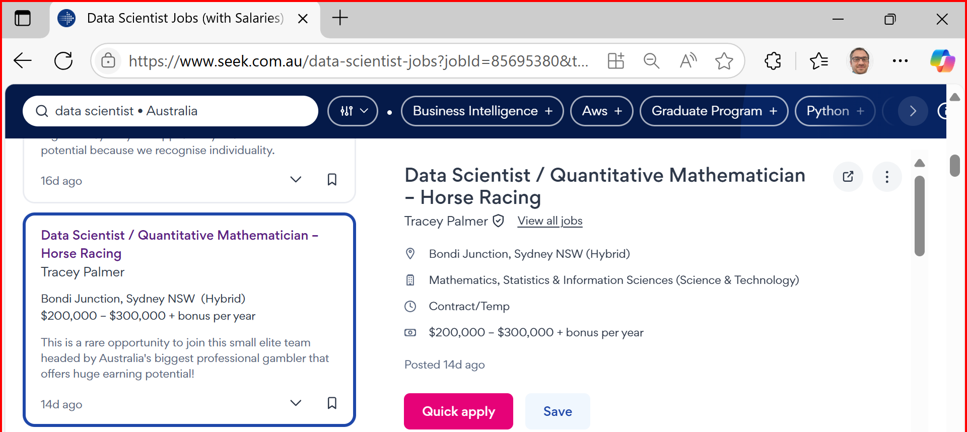
Career Opportunities & Certifications for ICT624 Graduates
Data Scientist Develop predictive models and uncover insights using ML & deep learning.

Slide 5
Career Opportunities & Certifications for ICT624 Graduates
Business Intelligence Analyst Translate analytics into strategic planning using BI tools.
Machine Learning Engineer Build and deploy scalable ML models in real-time systems.

Slide 6
Career Opportunities & Certifications for ICT624 Graduates
AI Solutions Consultant Advise on integrating AI into business operations.
Big Data Analyst Analyse large-scale datasets from cloud or distributed sources.
Advanced Analytics Consultant Design prescriptive models to solve industry-specific problems.

Slide 7
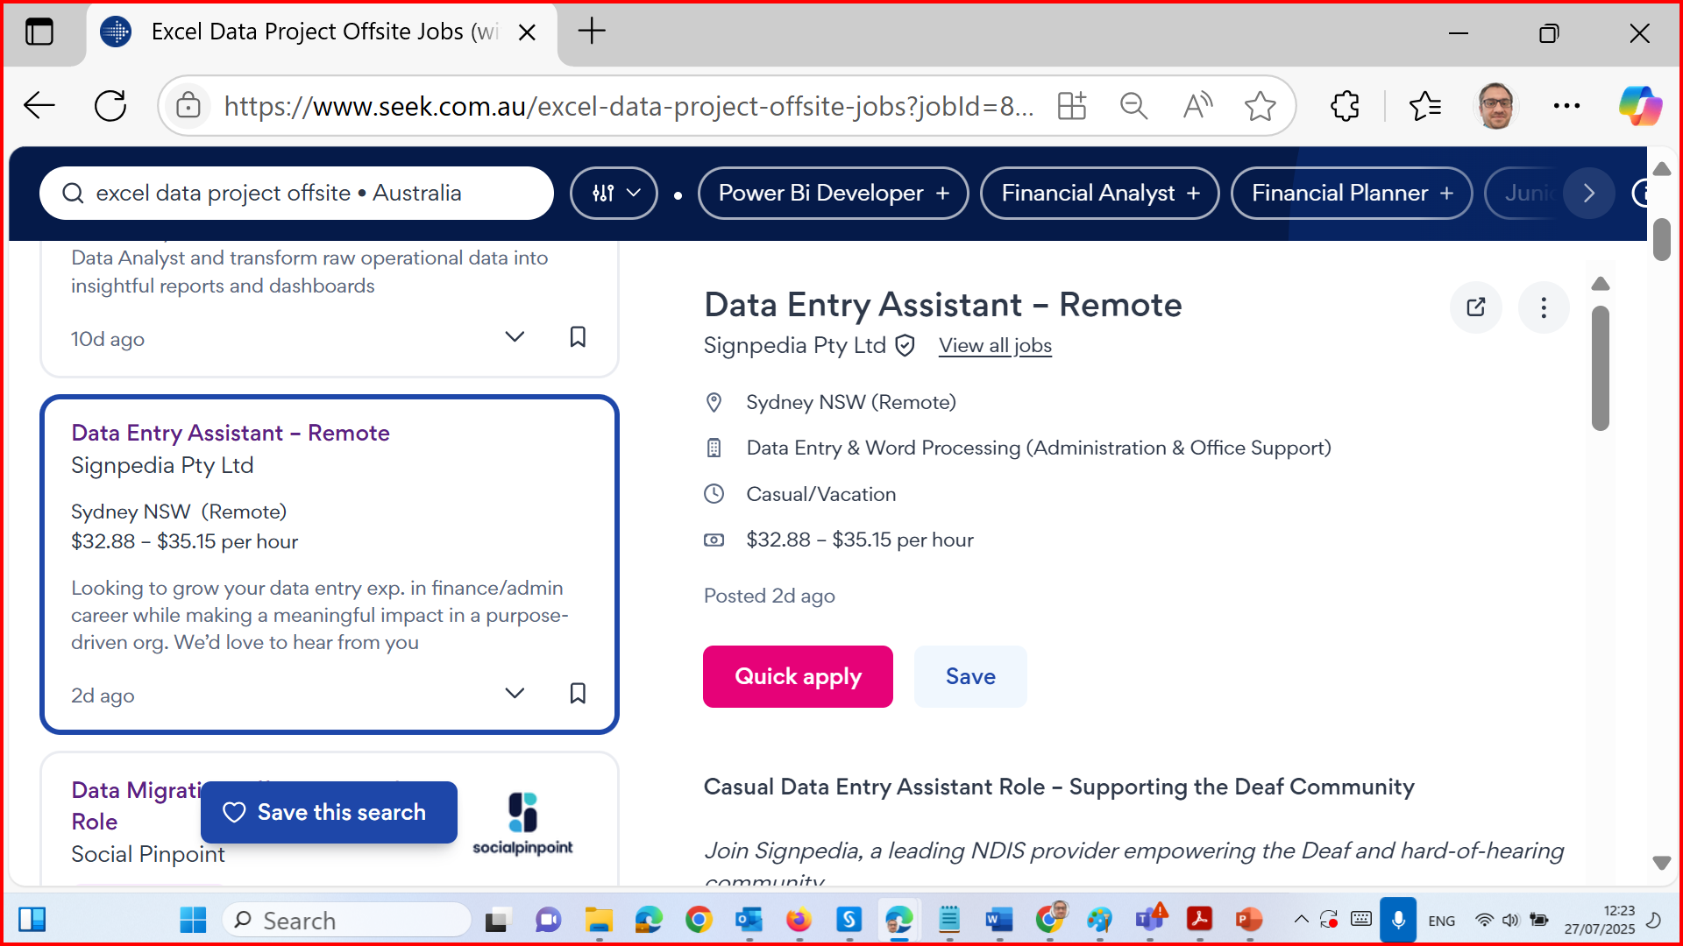
Career Opportunities & Certifications for ICT624 Graduates

Slide 8
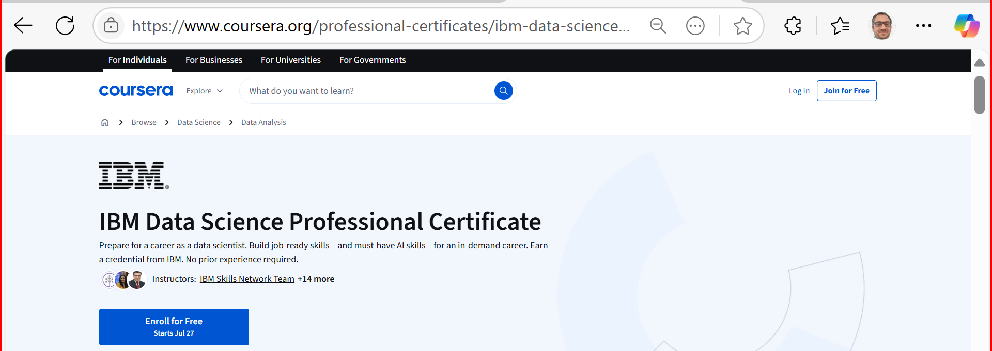
Career Opportunities & Certifications for ICT624 Graduates
Relevant Certifications (Optional/Recommended)
Enhance your employability with these recognised certifications:
IBM Data Science Professional Certificate (Coursera)

Slide 9
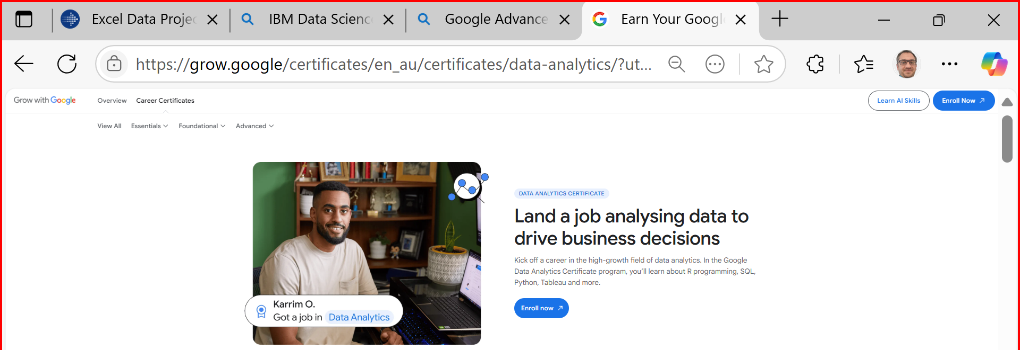
Career Opportunities & Certifications for ICT624 Graduates
Google Advanced Data Analytics Certificate

Slide 10
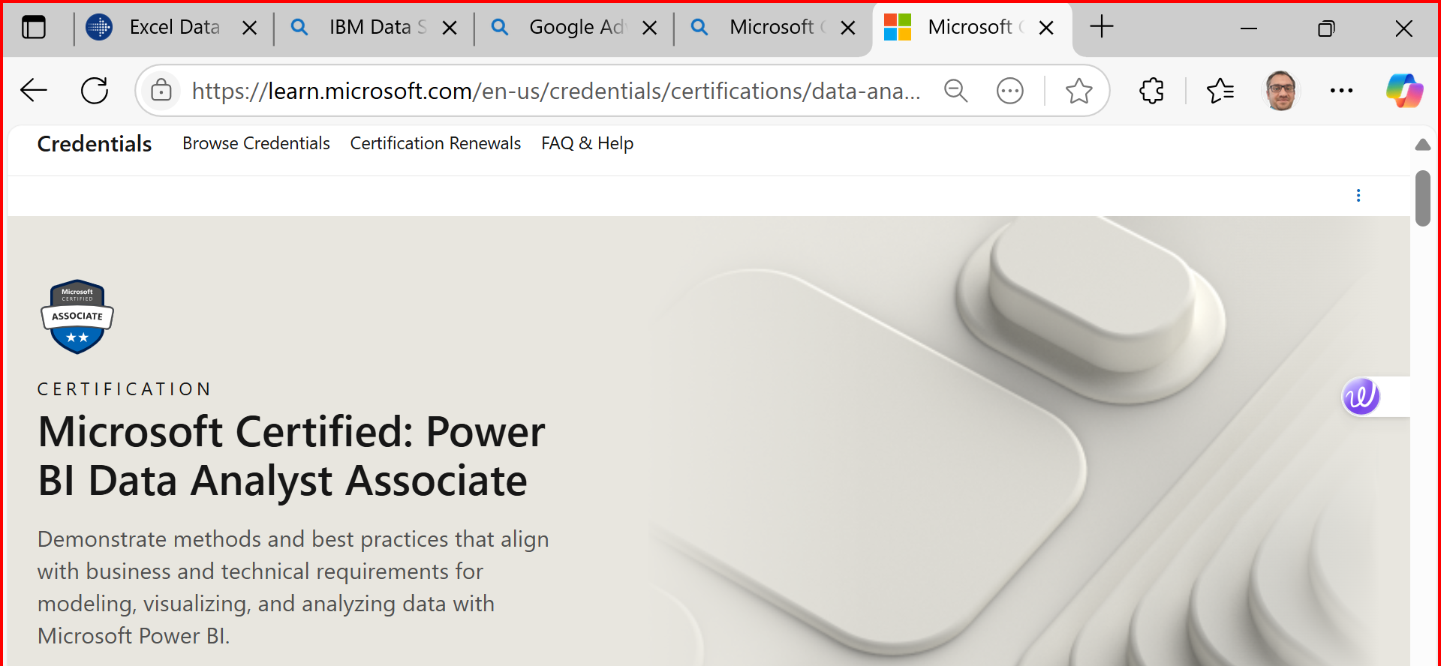
Career Opportunities & Certifications for ICT624 Graduates
Microsoft Certified: Data Analyst Associate (Power BI)

Slide 11
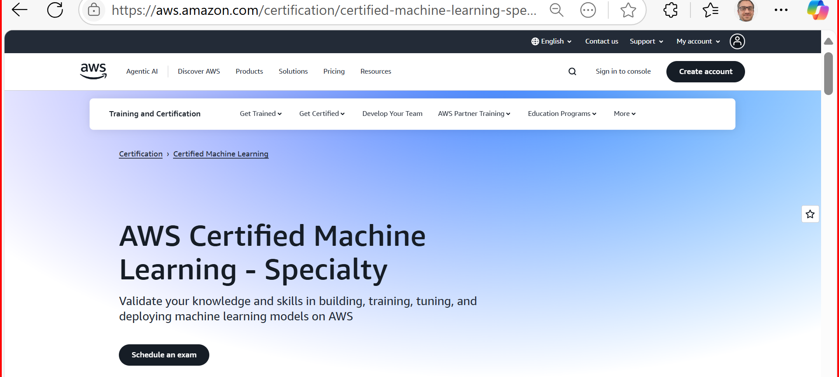
Career Opportunities & Certifications for ICT624 Graduates
AWS Certified Machine Learning – Specialty
SAS Certified Advanced Analytics Professional
Databricks Certified Data Engineer Associate

Slide 12
Unit Overview – HI6040: AI and ML
This unit introduces the foundational knowledge of Artificial Intelligence (AI) and Machine Learning (ML), focusing on:
Core ML algorithms and workflows
Application of AI in real-world decision-making
Use of tools like Azure ML, Python, and Colab
Understanding of ethical and social implications of AI
You’ll engage in guided labs, real-world case studies, and team collaboration activities that mirror professional environments.

Slide 13
Unit Expectations
Attend all tutorials and engage in practical activities
Join a group before the deadline for Group Facilitation (Weeks 5–11)
Complete the 2 online tests on time
Submit your individual assignment following all submission policies
Practice academic integrity and adhere to formatting and referencing requirements

Slide 14
Key Assessment Dates
Assessment | Due Date | Time | Notes
Test 1 (Online) | 19 August 2025 | 9:00 PM | 30 mins after launch
Test 2 (Online) | 30 September 2025 | 9:00 PM | 30 mins after launch
Group Facilitation | Weeks 5–11 (In Class) | In class | Join group before cutoff (TBA)
Individual Assignment | 8 October 2025 | 11:59 PM | Strict formatting and submission rules

Slide 15
What to Avoid
Submitting without a cover sheet or in the wrong format
Using screenshots or handwritten answers
Submitting via mobile/tablet or Blackboard App
Not joining a group before the deadline (will result in 20% penalty if solo)
Submitting from an overseas IP without clearance

Slide 16
Step-by-Step Installation Guide
Choosing the Right Tool for Python Programming:
New to Python? Use Anaconda – it comes with Python and most data science libraries pre-installed, making setup easy.
Comfortable with setup? Choose Visual Studio Code (VS Code) – it's lightweight and powerful. Just make sure to manually install any required libraries (e.g., NumPy, Pandas, Matplotlib).

Slide 17
Step-by-Step Installation Guide
Need cloud access or device flexibility? Try Google Colab – perfect for writing, running, and sharing code online. Ideal when working across devices or if local installation is restricted.

Slide 18
Step-by-Step Installation Guide
1. Install Anaconda (Optional) (Includes Python, Jupyter, pandas, numpy, etc.)
Why: Needed for local coding and Spark integration Steps:
Go to https://www.anaconda.com/download
Download Anaconda Individual Edition for your OS (Windows/macOS)
Follow the installation instructions (click Next > Accept > Install)
After install, open Anaconda Navigator or Jupyter Notebook from Start Menu

Slide 19
Step-by-Step Installation Guide
2. Set Up Google Colab (Recommended)
Why: Cloud-based notebooks used for labs and coding Steps:
Go to https://colab.research.google.com
Sign in using your student Google account
Create or open notebooks anytime without install
We’ll share lab notebooks weekly via Moodle

Slide 20
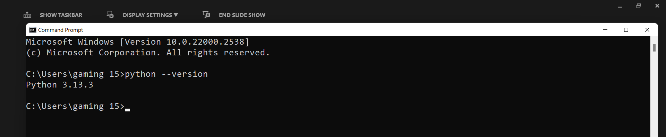
Step-by-Step Installation Guide
3. Install Visual Studio Code (Optional)
Step 1: Install Python
For Windows 11:
Go to the official site: https://www.python.org/downloads/
Download the latest Python 3.x Windows Installer.
Important: During installation, check the box that says Add Python 3.x to PATH before clicking Install Now.
After installation, open Command Prompt (cmd) and type: python --version
You should see the Python version printed. This confirms it's correctly installed and added to PATH.

Slide 21
Step-by-Step Installation Guide
3. Install Visual Studio Code (Optional)
For macOS:
Download the macOS installer from https://www.python.org/downloads/mac-osx/
Follow the installer instructions.
To verify, open Terminal and run:
python3 --version
(On Mac, we often use python3 instead of python.)
To update:
python -m pip install --upgrade pip

Slide 22
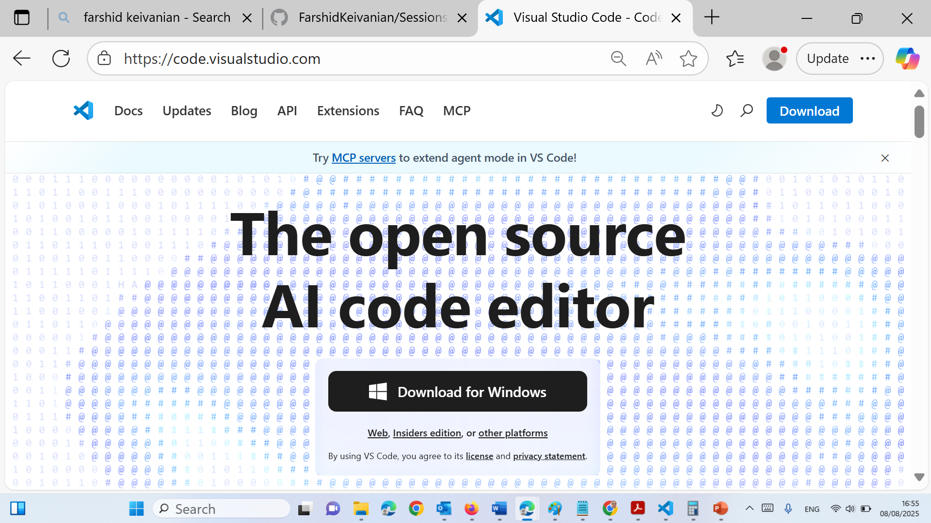
Step-by-Step Installation Guide
3. Install Visual Studio Code (Optional)
Step 2: Install VS Code
Download VS Code: https://code.visualstudio.com/
Install it like any other application.
Open VS Code.

Slide 23
Step-by-Step Installation Guide
Search and Install:
Search: Python
Install the Python extension by Microsoft (most important!).
(Optional but helpful) Install:
Jupyter (for .ipynb interactive notebook support)
Pylance (for IntelliSense)
Code Runner (if students want simpler one-click run for .py files)

Slide 24
Step-by-Step Installation Guide
Step 4: Enable the Run Button (play) with Interactive Window
Open a .py file or create a new file and save it as yourfile.py.
After the Python extension is installed, VS Code will show a play Run button in the top right.
Click the dropdown arrow next to the play and choose:
"Run Current File in Interactive Window".
If you are using a .ipynb (Jupyter Notebook) file, it will automatically show “Run Cell” and work interactively once the Jupyter extension is installed.

Slide 25
Step-by-Step Installation Guide
Step 5: Select Python Interpreter (If Not Detected)
Press Ctrl+Shift+P (or Cmd+Shift+P on Mac) to open the command palette.
Type: Python: Select Interpreter
Choose the one that shows your installed Python path (e.g., Python 3.x with correct version).

Slide 26
Step-by-Step Installation Guide
Troubleshooting Common Issues
Run Button Not Appearing?
Make sure:
Python extension is installed.
File is saved with .py or .ipynb extension.
Python interpreter is selected in bottom-left/status bar.
Getting “Python not found”?
On Windows, make sure Add to PATH was checked during installation.
On macOS, use python3 instead of python.

Slide 27
Summary Checklist
Step | Task | Windows | Mac
1 | Install Python | [ Add to PATH] | [Use python3]
2 | Install VS Code
3 | Install Extensions | Python, Jupyter | Same
4 | Configure Interpreter | Ctrl+Shift+P → Select Python | Same
5 | Run Code | Play → Interactive Window | Play works the same

Slide 28
Handle Error
Sometimes, students may see an error like:
"Cannot run cells, ipykernel is not installed." or "Kernel 'Python 3' cannot be started using the selected interpreter."
This happens if:
They installed Python but haven't installed any packages (especially in a new/clean environment).
They’re using a virtual environment that doesn’t have ipykernel.

Slide 29
Handle Error
To fix it (if needed), they can run:
On Windows (Command Prompt):
pip install ipykernel
On macOS (Terminal):
pip3 install ipykernel
Or from inside VS Code's terminal (Ctrl + ~), run:
python -m pip install ipykernel

Slide 30
Update
Install required libraries via terminal (CMD or VS Code terminal):
Windows: python.exe –m pip install --upgrade pip
VS Code (Python Update)
MAC: python.exe –m pip3 install --upgrade pip
Windows: pip install pandas numpy pyspark matplotlib jupyter
MAC:
pip3 install pandas numpy pyspark matplotlib jupyter

Slide 31
Add Jupyter Support
Install Jupyter extension in VS Code for using .ipynb notebooks
Run:
Windows: pip install notebook
MAC: pip3 install notebook

Slide 32
Extra Resources
Python latest version is preferred for this subject.
Install the latest Python: Download Link.
Configure Python on Windows: Demo Video.
Configure Python on Linux: Demo Video.
Configure Python on MacOS: Demo Video.
Once Python is installed on your operating system, setup Python with your preferred IDE. The configurations below demonstrate how to setup Python and Tkinter with vscode. You may choose different IDE (e.g. NetBeans) and configure Python within the IDE.
Configure Python with vscode: Reference Link.
Configure Python Tkinter with vscode: Demo Video.

Slide 33
If you use Visual Studio Code (Install these packages)
pip install numpy pandas matplotlib scikit-learn seaborn jupyter
You can run .ipynb notebooks in VS Code and execute Python code without issues.

Slide 34
If you use Visual Studio Code (Add this extension)
In VS Code → Extensions (Ctrl + Shift + X) → Search for "Jupyter" → Install

Slide 35
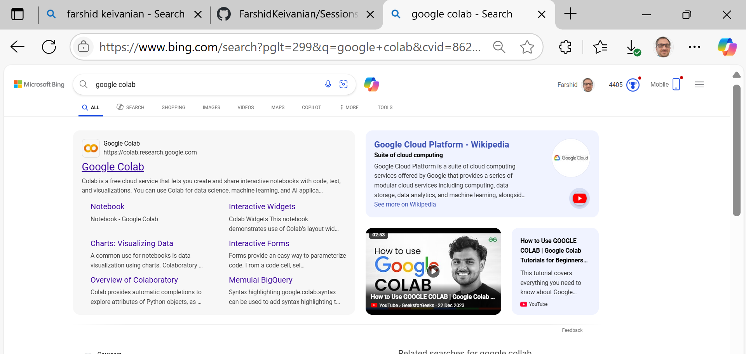
If you use Google Colab

Slide 36
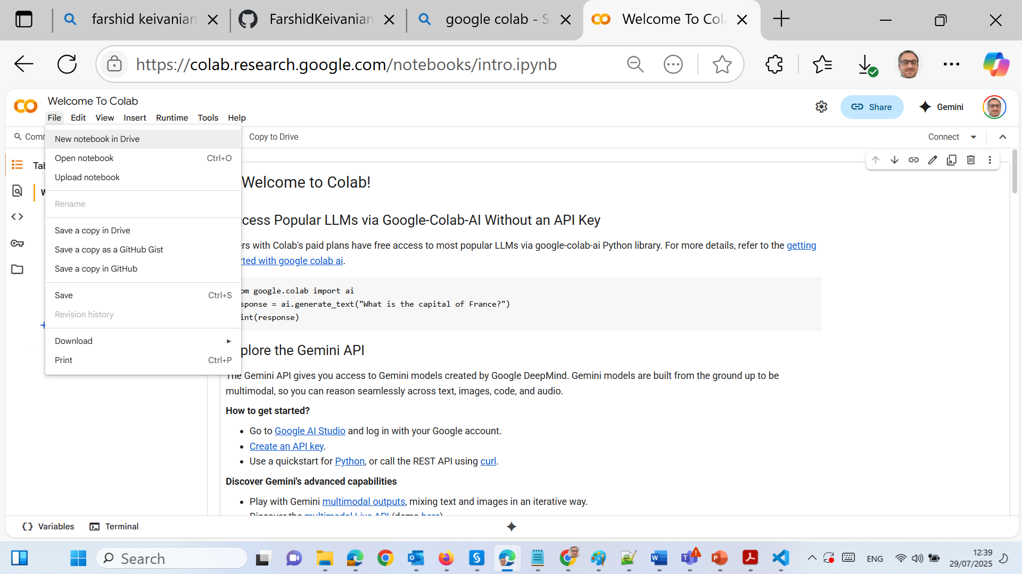
If you use Google Colab

Slide 37
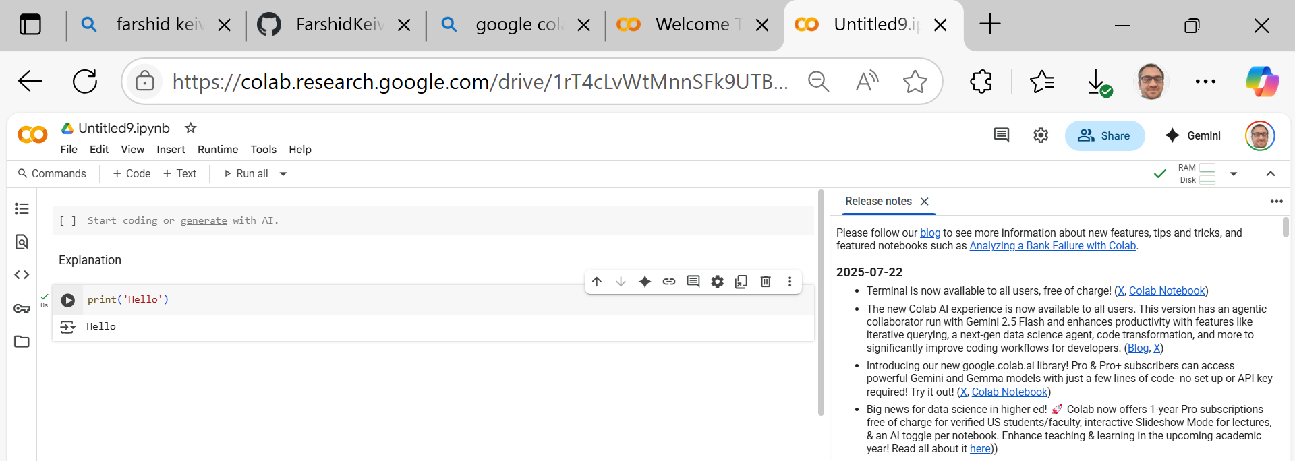
If you use Google Colab

Slide 38
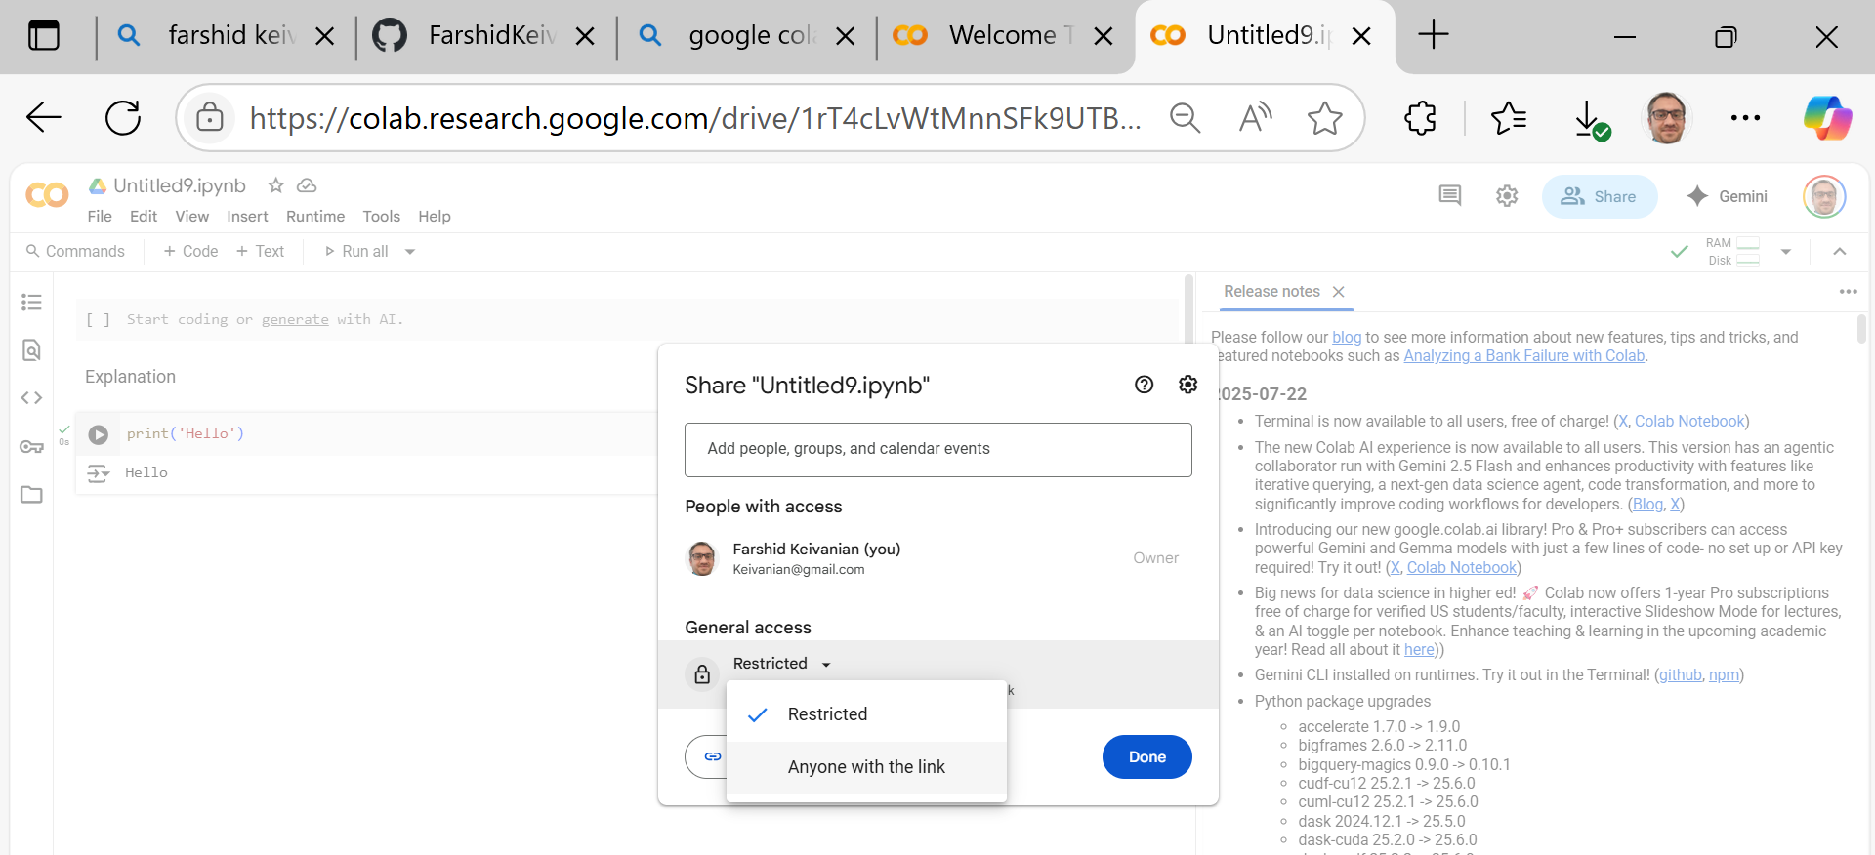
If you use Google Colab

Slide 39
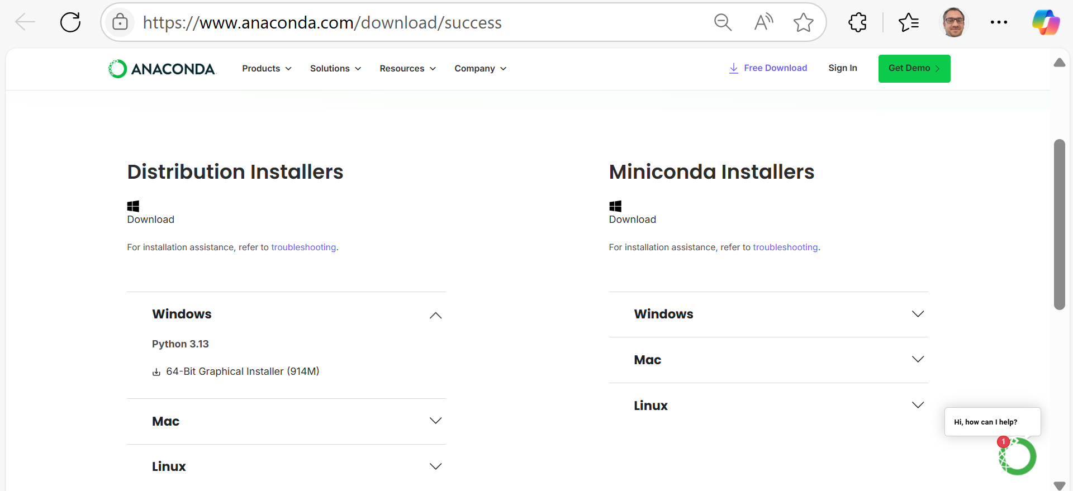
Week 2 Tutorial – Step-by-Step Instructions
If you use Anaconda – Follow these steps:
Windows/Mac/Linux
Distribution Installers → Windows / Mac / Linux (based on their OS)

Slide 40
Week 2 Tutorial – Step-by-Step Instructions
If you use Anaconda – Follow these steps:
Launch JupyterLab
From Anaconda Navigator, open JupyterLab.
It will open in a browser.
Create a new Python Notebook.
Write and Run Python Code
Use the grey code cells to write and run Python code.
Output appears below the code block.

Slide 41
Week 2 Tutorial – Step-by-Step Instructions
PART B: Cloud Setup with Google Colab
Log into Google Drive with your Gmail account.
Create or open a Colab Notebook Go to: https://colab.research.google.com Or open from Google Drive > New > More > Colab.
Write and run Python code Use the Runtime menu to run cells.

Slide 42
Week 2 Tutorial – Step-by-Step Instructions
PART C: Azure ML Studio Setup
Login via Skillable Labs Go to: https://msle.learnondemand.net
Sign in via Skillable Account
Username: your student email
Password: Holmes1234&

Slide 43
Week 2 Tutorial – Step-by-Step Instructions
Launch Your Lab
Click "Launch", then navigate to Resources.
View your login credentials and workspace access.
Explore Azure ML Studio
Visit: https://studio.azureml.net
Log in and create a workspace if required.
Explore three options: Automated ML, Designer, Notebooks.
For Week 2, click Designer and select Start Now.

Slide 44
Week 2 Tutorial – Step-by-Step Instructions
Navigate ML Designer
Use drag-and-drop tools for model creation.
Understand core elements: datasets, algorithms, evaluation blocks.

Slide 45
Learning Outcome by End of Week 2
Compare development environments: local (Anaconda/Jupyter) vs cloud (Colab, Azure ML)
Navigate Azure ML Studio Designer for low-code ML
Run Python code in Jupyter or Colab environments

Slide 46
To Do This Week
Attend the tutorial and complete the setup steps above
Create and save a basic Jupyter/Colab notebook with at least one ML-related Python example (e.g., linear regression with scikit-learn)
Begin exploring Azure ML Studio Designer and familiarize yourself with drag-and-drop interface

Slide 47
To Do This Week
If you face issues, bring your laptop to the tutorial session or contact the support tutor for assistance.
Let’s build a strong technical foundation this week!

Slide 48
Thank You
Need Help? Send an email or ask during the tutorial session.
FKeivanian@my.holmes.edu.au

